Slide 1
Steps to Postprocessing of RVEs
Aim:
Generated RVEs files
FIP(P_{max}) distributions analysis
by B.Sc. Shanxu Li

Slide 2
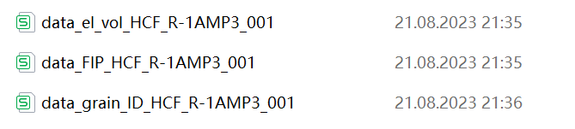
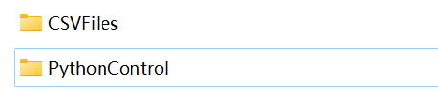
Step1
First ensure RVEs including .odb are generated
Locate the only one RVE folder (e.g. 50 RVEs in total) on the cluster platform
Operate the command in “Run ReadOdb” file on the cluster platfom
(attention: ABAQUS version and rename the output files)
Result: obtain required excels
Repeat for 50 RVEs and pack all 150 output files in one folder which is parallel to “PythonControl” folder

Slide 3
Step2
Edit “Postprocessing.py”
Lines needed to be modified based on specific conditions have been noted with #####,
.
Edit “FIP_Calc.py”
Edit “Config. json”
Lines 2-18, 48-52 to be modified based on specific conditions.

Slide 4
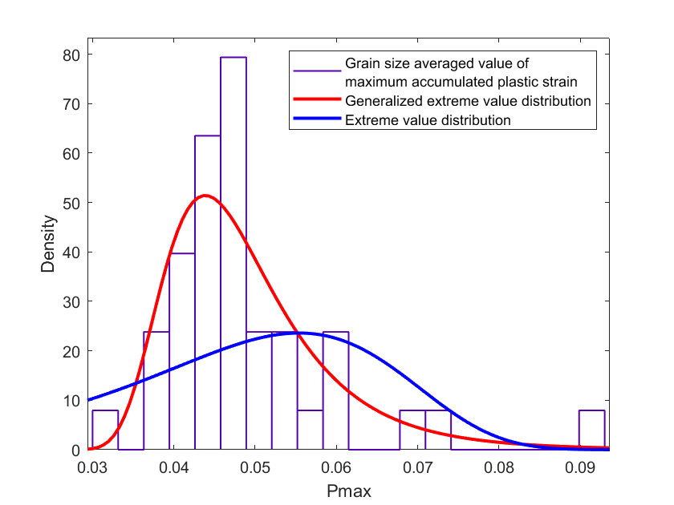
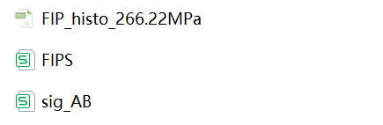
Step3
Run “Postprocessing.py” by Python IDE (e.g. Pycharm)
Assemble required Terminals
Result: folder “Postprocessing” is output
including:
Further process the table in Matlab and plot the detailed distribution by App-DistributionFilter
Distribution histogram
FIP value of each RVE
A, B, k and ΔPmax etc.

Slide 5

Thank you

